Slide 1
Higher media Paper 1 - Analysis

Slide 2
Analysis paper structure
What you will be tested on:
Your ability to analyse how key aspects have been used in Get Out, and how they have been affected by the contexts in which it was made.
Your ability to use the key aspects and contexts to analyse unseen posters
Key Aspects:
Categories (Genre, Purpose, Tone, Style)
Language
Narrative
Representations
Contexts:
Society
Institutions
Audience

Slide 3
The Key Aspects
Society
Institutions
Narrative
Representation
Get Out
Categories
Language
Audience

Slide 4
Content-Based Key Aspects
Categories
Narrative
Language
Representation

Slide 5
Categories
Genre – Horror Conventions (e.g. Bad Place; Monster; Survivor; Jump Scare etc.)
Purpose – To entertain / make profit / comment on racism
Tone – Sinister / Suspenseful etc.

Slide 6
Narrative
Todorovian structure – equilibrium, disruption, recognition, attempt to repair, new equilibrium
Hero’s journey – ordinary world, call to adventure, first threshold, supreme ordeal/inmost cave, road back
Barthes’ Codes – hermeneutic, proairetic, semic, semantic, referential
Binary Oppositions

Slide 7
Language
Technical and Cultural Codes:
Mise-en-scene
Use of camera
Sound
Colour
Lighting
Editing

Slide 8
Representation
Ideologies – colour-blind liberal ideology
Selection and Portrayal – how characters, places ideas are represented through plot, action, dialogue, mise-en-scene etc. in ways that reflect or challenge ideology

Slide 9
Writing about content-based Key Aspects
10 mark questions
In question 2 part a), you will be asked to analyse a content-based key aspect, e.g.
(a) analyse the ways in which narrative has been used in the construction of the media content 10

Slide 10
Writing about content-based Key Aspects
To get full marks, you need to analyse ‘at least two relevant concepts’ so it’s a good idea to aim for three!
A ‘relevant concept’ could be e.g.
One genre convention analysed in detail
One narrative concept (e.g. Barthe’s codes) analysed in detail
A range of language codes analysed in one scene
One representation analysed in detail

Slide 11
Writing about content-based Key Aspects
For each concept:
Decode it in detail – i.e. Explain what the concept is and how it is usually used
Explain in detail how it is used in Get Out – give detailed reference to the film to support your discussion
Comment insightfully on what is interesting or different about the way it is used in Get Out – link to purpose (profit, entertainment, social commentary) wherever possible

Slide 12
Another common convention of horror is an evil villain or monster, often supernatural and usually something that comes from outside society and threatens the safety of the characters. Because the purpose of ‘Get Out’ is to criticise racism and white supremacy, the film puts an original twist on this convention as the villains turn out to be the racist white people, most prominently Rose and her family. These villains are unexpected, especially Rose as they all make a point out of proving that they are not racist; yet they are extremely racist. For example, Rose’s father tells Chris ‘If I could’ve voted for Obama a third time, I would have’. The fact is that the Armitages go out of their way to appear very accepting of black people so that they do not appear racist. However, later in the film we find out that they have actually been removing the brains of several black people and putting the brains of their older white friends into the black person’s body due to many ‘advantages’ that they believe black people have. This is symbolic of the appropriation of black culture in our society; white people are often seen ‘stealing’ black culture to try and make it their own. There is something unbelievable and bizarre about the brain swapping; the idea is weird and adds an almost grotesque effect to the film’s use of horror conventions.

Slide 13
Writing about content-based Key Aspects
For each concept:
Decode it in detail – i.e. Explain what the concept is and how it is usually used
Explain in detail how it is used in Get Out – give detailed reference to the film to support your discussion
Comment insightfully on what is interesting or different about the way it is used in Get Out – link to purpose (profit, entertainment, social commentary) wherever possible
Task: Pick a key aspect concept and practise writing a paragraph of analysis using this structure

Slide 14
Writing about Contexts
Use the same structure as for writing about key aspects
Write about at least 2 features of the concept (e.g. institutional factors / society factors / specific audience responses etc.) and for each one:
Decode it in detail – i.e. Explain fully what the factor is
Explain in detail how it can be seen to have affected (or be affected by) Get Out – give detailed reference to the film to support your discussion
Comment insightfully on what is interesting or different about the effect it has on Get Out

Slide 15
Analysis paper structure
2 hours 15 minutes long
Question 1 – Essay question on Get Out: 20 marks, split into a) and b) sections worth 10 marks each
Question 2 – Essay question on Get Out: 20 marks, split into a) and b) sections worth 10 marks each
Question 3 – Print analysis question on a pair of film posters: 10 marks

Slide 16
Analysis paper structure
Essay questions:
Question 1 – Essay question on Get Out: part a) will ask about one specific context (SOCIETY, INSTITUTIONS or AUDIENCE), and part b) will ask you to analyse how it has affected any or all of three key aspects (from CATEGORIES, LANGUAGE, NARRATIVE and REPRESENTATION)
Question 2 – Essay question on Get Out: part a) will ask about one specific key aspect (whichever was not listed in question 1), and part b) will ask you to analyse how it was affected by one or both of the contexts that were not asked about in question 1

Slide 17
Specimen paper question 1
1. How audiences respond to media content can depend on the extent to which key aspects such as narrative and/or language and/or representations have been used to construct the content.
Analyse how this statement applies to media content you have studied. In your response you should:
(a) analyse the ways in which different audiences might respond to the media content 10
(b) analyse the ways in which these responses might depend on the use of language and/or representations and/or narrative. 10

Slide 18
Specimen paper question 2
2. The ways in which categories are used in the construction of media content can be influenced by society and/or institutional factors.
Analyse how this statement applies to media content you have studied. In your response you should:
(a) analyse the ways in which categories have been used in the construction of the media content 10
(b) analyse the ways in which society and/or institutional factors have influenced the use of categories. 10

Slide 19
What you need to know
You need to be able to write a detailed analysis of each of the key aspects (categories, language, narrative, representations) and each of the contexts (society, institutions and audience), giving detailed examples from the film of how they have been used / how they can be seen.
You need to be able to make detailed comments explaining how each of the key aspects (categories, narrative, language, representations) has been affected by any of the contexts (society, institutions, audience).

Slide 20
Higher media analysis essay planning
No matter which key aspects or contexts you are asked to write about, you need to follow a similar structure for each essay:
Part a) – aim to discuss at least 2 (ideally 3) different concepts from the key aspect/context (i.e. different narrative theories; different sequences for language; different institutional or society factors etc.). For each one:
Decode (describe) the concept in detail
Explain: give detailed evidence from the film showing how the concept can be seen in it
Comment in detail on why the concept has been used the way it has

Slide 21
Part b) - aim to discuss at least 2 (ideally 3) different concepts from the key aspect/context (i.e. different narrative theories; different sequences for language; different institutional or society factors etc.). For each one:
Decode (describe) the concept in detail
Give detailed evidence from the film showing how the concept can be seen in it
Comment in detail on how this use of the key aspect has influenced/been influenced by the key aspect or context you wrote about in a)

Slide 22
2016 essay question
1. Media Content in Context
Internal and external institutional factors often influence the way that key aspects of media content are constructed.
Analyse how this statement applies to media content you have studied. In your response you should:
give detailed information about internal and/or external institutional factors which have influenced the media content; 10
analyse how categories and/or representations and/or language codes have also been influenced by these institutional factors. 10

Slide 23
Specimen paper question 2
2. The ways in which categories are used in the construction of media content can be influenced by society and/or institutional factors.
Analyse how this statement applies to media content you have studied. In your response you should:
(a) analyse the ways in which categories have been used in the construction of the media content 10
(b) analyse the ways in which society and/or institutional factors have influenced the use of categories. 10

Slide 24
Specimen paper question 2
2. The ways in which categories are used in the construction of media content can be influenced by society and/or institutional factors.
Analyse how this statement applies to media content you have studied. In your response you should:
(a) analyse the ways in which categories have been used in the construction of the media content 10
(b) analyse the ways in which society and/or institutional factors have influenced the use of categories. 10

Slide 25
Marking scheme

Slide 26
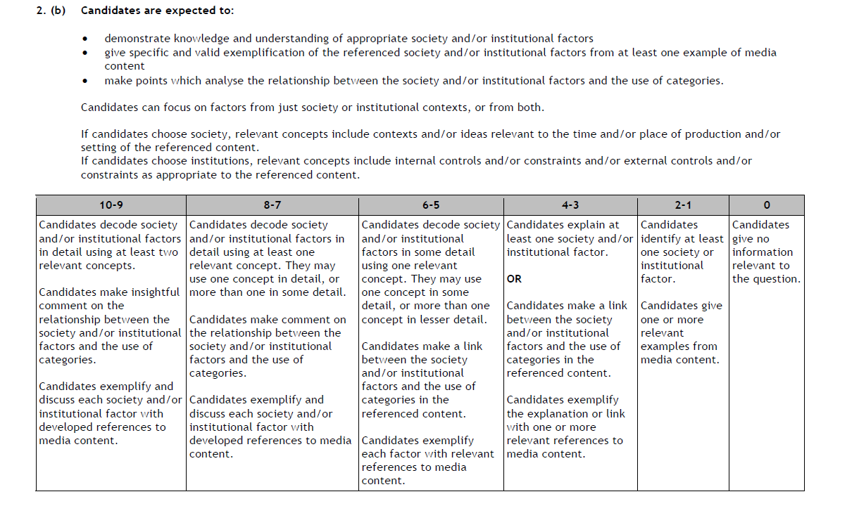
Marking scheme

Slide 27
Essay planning
– Categories (Genre / Purpose / Tone):
Two sentence (maximum) intro giving name of film, director, genre
Choose 3 or 4 genre conventions, and for each one:
Decode it in detail – i.e. Explain what the convention is and how it is usually used
Explain in detail how it is used in Get Out – give detailed reference to the film to support your discussion
Comment insightfully on what is interesting or different about the way it is used in Get Out – link to purpose (profit, entertainment, social commentary) wherever possible
Do the same for tone (best example to use for tone is the ‘sunken place’ sequence)

Slide 28
Essay Planning
B) – Society + categories
Decode society factor 1 (racism / history of slavery etc.), and give a brief account of how it can be seen reflected in the film as a whole
Analyse 2 or three examples where this factor has influenced categories (refer to specific genre conventions, tones etc. and comment insightfully on how the society factor has affected the way categories are used)
Do the same for society factor 2 (BLM etc.) OR for an institutional factor

