Slide 1
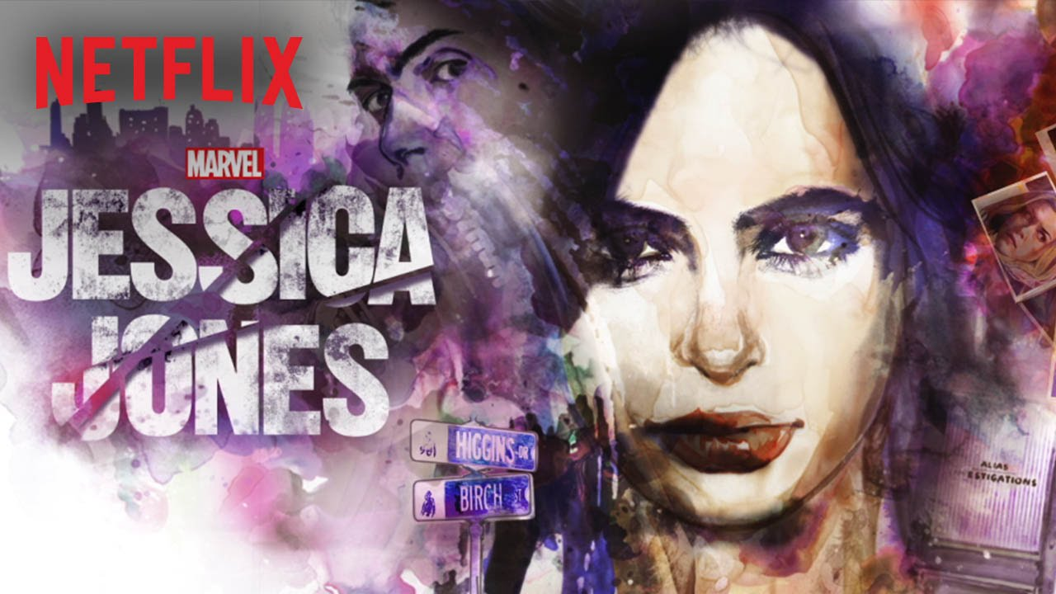
Society Factors

Slide 2
Society factors
4. Media content cannot be separated from its context in society.
Explain in detail how media content you have studied has been affected by the
society in which it was made and/or set. 8
3. Media content reflects ideas from the time/place in which it was made and/or set.
(a) Describe relevant ideas from the time and/or place of the media content you have studied. 4
(b) Explain in detail how this content reflects these ideas. 6

Slide 3
Society factors
You need to be able to explain at least two ideas from the time and/or place of the making / setting of the text, and give examples of how their influence can be seen in the text.

Slide 4
Factor 1 - Feminism
Society factor 1: Feminism – attitudes to traditional gender roles have been greatly affected by the feminist movement over the last 50 years
Effect on the show:
Jessica Jones is an unconventional female protagonist, adopting many traditionally male roles:
Most superheroes have traditionally been male, so Jessica is unusual in that respect, but follows in the line established by shows like Buffy the Vampire Slayer in having a young female character (usually the victim in horror/action films) able to stand up to and defeat the villains through her own powers.
Traditionally, the protagonists of noir films are almost exclusively male, so Jessica’s role as the cynical, hard-drinking PI reflects the breaking-down of traditional gender roles.
Jessica is portrayed as in control of her sexuality, seducing Luke Cage and standing up to the sleazy man who tries to pick up her and Trish in a bar. This also breaks down traditional gender roles because normally men have been the ones expected to initiate sexual relationships
We can also see this reflected in the fact that Jessica doesn’t turn to a man to help her out – throughout the series her most consistent companion is Trish, who we also see trying to break out of traditional passive non-violent feminine roles through learning self-defence.
Hogarth’s role at the law firm also reflects this – she is a woman who is highly successful and holds a position of authority in a male-dominated industry.
The show also challenges stereotypical ideas about family: Jessica and Trish are adopted sisters but their bond is stronger than any blood relationships in the show (e.g. Trish hates her mother; Kilgrave hates his parents); When Jessica lives with Kilgrave for a while, it is like a parody of a stereotypical family home, where the staff are in fear of their lives and Jessica and Kilgrave completely distrust each other

Slide 5
Factor 2 – attitudes to LGBT people
Factor 2: Gay marriage – was legalized in America in June 2015 (shortly before the show went into production), reflecting much more liberal attitudes towards sexuality in American society
Effect on the show:
Hogarth’s marriage reflects this factor, and the way the show treats her infidelity also reflects the increased acceptance of gay characters in mainstream TV:
In the recent past, it would have been very difficult to show Hogarth cheating on her wife with a younger woman (stereotypically the behavior of a male boss who uses his power to seduce younger more attractive co-workers) – it would have been seen as homophobic
The way JJ shows Hogarth behaving in such a negative way could be argued to reflect social change – TV no longer has to portray gay people simply as noble role models, but can reflect their flaws in a much more realistic way. The gay characters in the show are simply treated as ordinary, flawed human beings – their sexuality does not define their role in the show in any way

Slide 6
Factor 3 – fear of terrorism
Factor 3 - Fear of terrorism – following 9/11, America has been alert to the possibility of serious attacks on its major cities, especially New York
Effect on Show:
Lots of references to ‘the incident’ (the attempted alien invasion of New York shown in Avengers Assemble reflect the impact that the 9/11 attacks had on New Yorkers’ sense of safety

Slide 7
Factor 4 – Awareness of Domestic abuse
Factor 4 - Increased awareness of domestic & sexual abuse. In recent years, society has become much more aware of the harm done by domestic abuse
Kilgrave’s superpower reflects the power that abusers have over their victims – he can make people do whatever he wants just by telling them, and this is a chilling metaphor for the way that abusers often are able to control their victims, seemingly without using any violence.
The show provides a challenging but powerful vision of the effects of this on Jessica as we see her struggle with her PTSD and alcoholism throughout the series.

Slide 8
Society factors
4. Media content cannot be separated from its context in society.
Explain in detail how media content you have studied has been affected by the society in which it was made and/or set. 8
3. Media content reflects ideas from the time/place in which it was made and/or set.
(a) Describe relevant ideas from the time and/or place of the media content you have studied. 4
(b) Explain in detail how this content reflects these ideas. 6

