Slide 1
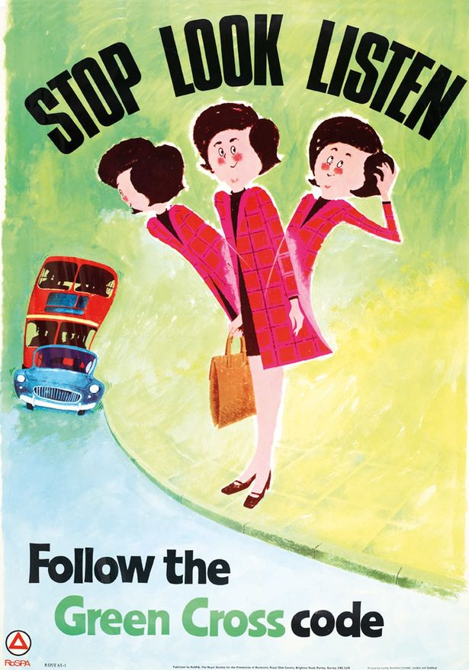
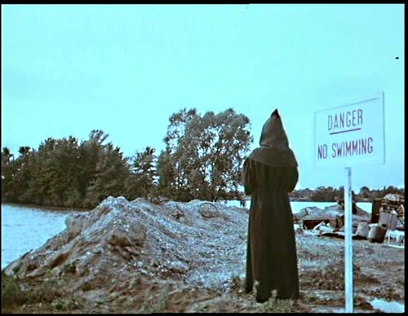
Public Service Advertising
PSA

Slide 2
PSAs
Much advertising aims to promote products or brands
It is paid for by the company that makes the product
Its aim is to make a profit
Public Service Announcements (PSAs) are different:
They aim to raise awareness about an issue and/or change public behaviour
They are paid for by Government institutions and/or charities
They do not aim to make a profit

Slide 3
PSAs
Product ads and PSAs have a lot in common, though:
Both try to make the viewer change their behaviour in some way, even if that just means they change their brand of washing-up liquid
They use many of the same advertising techniques:
Humour
Shock
Emotional manipulation
Repetition
Slogans
Broadcast ads use film language (Mise-en-scene; Use of camera; Sound; Colour; Lighting; Editing) to address their audience.
They often create mini-narratives in order to hook the viewer.

Slide 4
PSAs
Watch the following 2 PSAs and make notes on how each one emphasises its message by using:
Film Language (Mise-en-scene; Use of camera; Sound; Colour; Lighting; Editing)
Humour
Shock
Emotional manipulation
Narative
For each advert, explain in a couple of sentences what public service it is intended to perform, and how effectively you think it does so

Slide 5
PSAs

