Slide 1
Environmentally friendly design

Slide 2
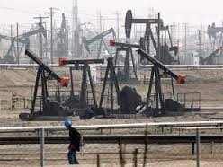
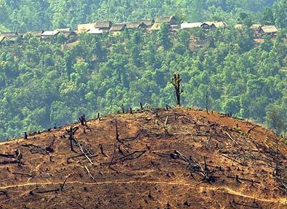
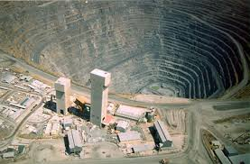
Environmental issues
What will happen if we..
Rely too much on oil? Oil and other fossil fuels release CO2 into the atmosphere and contribute to global warming.
Do not replant felled trees with new trees? In some parts of the world such as the Amazon rainforest, trees are cut down to create farmland. This ‘deforestation’ is reducing the ability of the earth to absorb CO2 and create oxygen
Keep digging for raw materials?
Metals and minerals will not last for ever. Eventually they will run out.

Slide 3
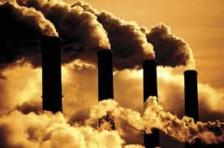
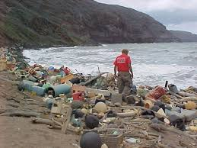
Environmental issues
What impact do our products have on the environment?
Many industrial processes cause damaging pollution and many products need energy to work. Some of this energy is still produced by polluting power stations.
When products are thrown away the materials are often wasted. In some cases they end up in the sea and are damaging the environment.

Slide 4
Environmental issues
Worksheet task 1
In your own words, describe some of the ways in which we are damaging the environment.
Some of the ways in which we are damaging the environment include…

Slide 5
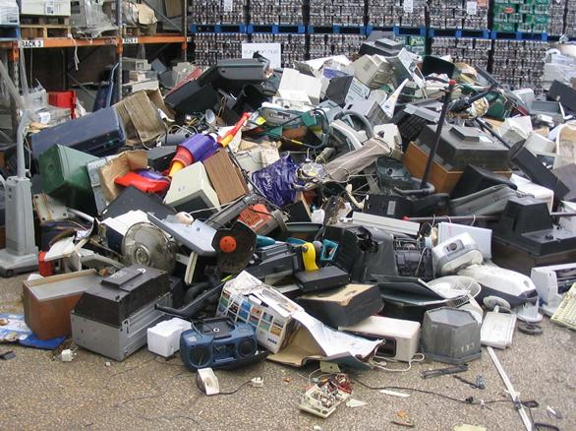
What should we do with products that are no longer useful?

Slide 6
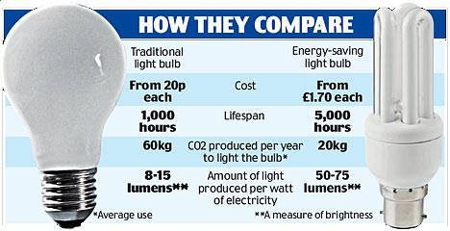
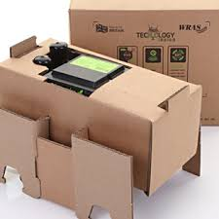
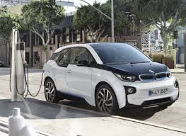
Reduce
Use less packaging for products.
Buy light bulbs that will last a lot longer (and use less electricity).
Electric cars produce less emissions and don’t rely on fossil fuels.

Slide 7
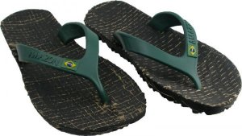
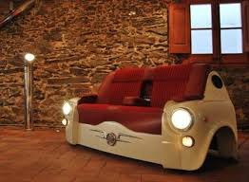
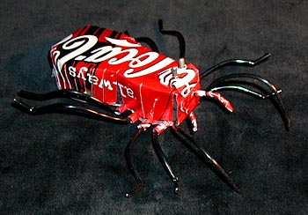
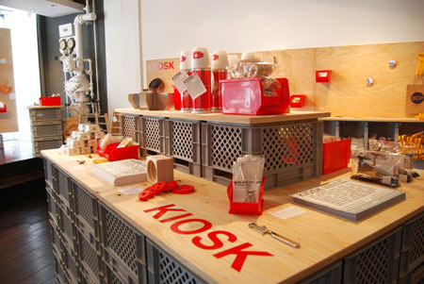
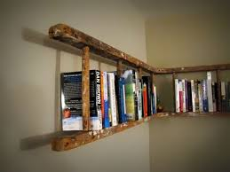
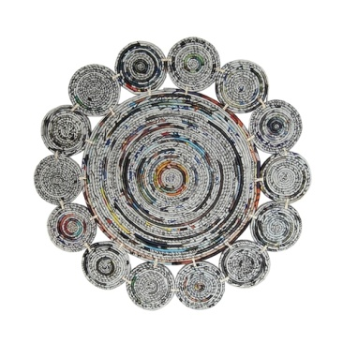
Re-use
Flip flops made from packaging
Car tyre sandals
Sofa from a car!
Toy made from a tin can
Shop display using plastic crates
Hot pot stand made from coiled paper
Ladder to book shelf

Slide 8
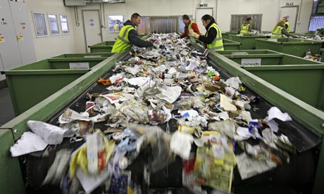
Recycle
How are materials recycled?
What Happens to Your Recycling After It's Collected? | NowThis

Slide 9
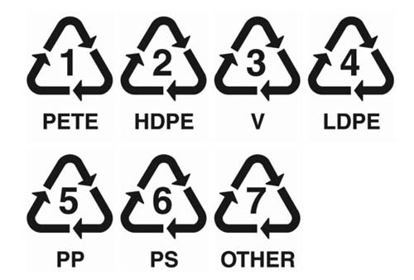
How do we make recycling easy?
Make the products easy to take apart
Label the materials used
These symbols can be found on most plastics. There are many different types of plastics and although many can be melted down and recycled, they must be sorted into the different types. Each symbol represents a different type of plastic and this helps us to sort them easily.
Complete worksheet task 2

Slide 10
Other ways to reduce our impact on the environment
Reduce energy use
Try to reduce the amount of energy that you use. For example, many products such as fridges and washing machines have a rating to tell you how energy efficient they are. When boiling water in a kettle, try to only fill it with just enough water. For example if you are making two cups of tea then only fill the kettle with two cups of water.
Do you really need it?
Next time you are going to buy something ask yourself, ‘Do I need this?’ There are many things that we buy, use for a short time and then throw away. Only buy things that you really need.
Repair
If something stops working then try to repair it. Learn the skills needed to fix things. It will save you money and help the environment too.

Slide 11
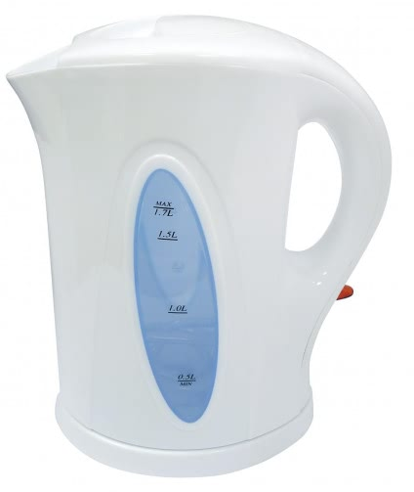
Case study
This kettle is made from plastic. It
will last for about 3 years before
the switch or heating element
stops working. However it only
costs £7.99 so I can replace it
easily.
Worksheet task 3
Suggest how we can make the kettle more environmentally friendly.

Slide 12
How can we reduce our impact on the planet?
Worksheet task 3
In your own words, describe some of the ways in which we reduce our impact on the environment.
Some of the ways in which we can save the environment include…

Slide 13
Video
Watch the video on the circular economy
This video describes our current approaches to production and examines how we can change the ways in which we make and use things to protect our environment.
The Circular Economy

Slide 14
Poster task
Open up a new Google Doc by clicking on the Add Create button at the top right of the screen.
Make a poster with a message to encourage peoples to live in and environmentally friendly way.
Recycle plastics
Walk instead of taking the car
Don’t buy over packaged goods
Use a re-useable coffee cup

